Slide 1

PRICE COMPARISON
Bachelor of Technology
In
Information Technology
By
V. HARSHITHA 22R21A1259

Slide 2
Contents
Abstract
Problem Statement
Objectives
Domain/System Requirements
Automation Tools
Scope of the Project
Introduction
Gap Analysis
Introduction of Existing system
Design Using DFD
Screenshots
Conclusion

Slide 3
Abstract
This price comparison website for products will help to compare the price from various e-commerce websites, This Price comparison site is extremely helpful for frequent online shoppers to check prices on different online stores in one place. But since it is very difficult to visit each & every website for price comparison, there needs to be a solution to automate this process. The Price comparison website project proposed here gathers information on product prices from various websites & presents it to the users. The users can then choose to buy from the best options available.

Slide 4
Problem Statement
With the rapid growth of online shopping, consumers often struggle to find
the best deals due to varying prices across multiple e-commerce platforms.
Manually checking each website is time-consuming and inefficient. There
is currently no reliable, centralized tool that allows real-time comparison
of product prices across platforms like Amazon, Flipkart, eBay, and
others. This results in users overpaying or missing better deals.
Additionally, many websites use anti-scraping mechanisms that make data
extraction difficult. A smart, automated solution is needed to streamline
this process and help users make informed purchasing decisions quickly.

Slide 5
Objectives
Develop a User-Friendly Price Comparison Tool Build an intuitive web interface that allows users to search and compare product prices across multiple e-commerce platforms.
Simulate Real-Time Pricing Data Generate realistic price, discount, rating, and review data based on product type and platform characteristics.
Highlight the Best Deals Identify and visually mark the platform offering the lowest price for the searched product.
Ensure Cross-Platform Representation Compare product prices from major Indian e-commerce sites such as Amazon, Flipkart, eBay, Meesho, and Myntra.
Implement Responsive and Modern UI Design Design a clean, mobile-friendly interface using HTML, CSS, and JavaScript to enhance user experience.

Slide 6
System Requirements
1. Hardware Requirements
Processor: Intel Core i3 or higher
RAM: Minimum 4GB
Storage: At least 500MB free space for program files and dependencies.
Internet Connection: Required for real-time web scraping.
2. Software Requirements
Operating System: Windows, macOS, or Linux.
Visual StudioCode

Slide 7
Automation Tools
Live Server – Automatically reloads the webpage during development
Prettier – Auto-formats code for clean and consistent style
GitHub – Version control and collaboration
GitHub Pages / Netlify – Automates deployment of the web app
JavaScript (ES6 Promises) – Automates simulated data fetching

Slide 8
Scope of the Project
The scope of this project is to develop a web-based Smart Price Comparison Tool that allows users to search for products and compare prices across leading Indian e-commerce platforms such as Amazon, Flipkart, eBay, Meesho, and Myntra. The tool simulates real-time product data including prices, discounts, ratings, and reviews to help users identify the best available deal. It supports a wide range of product categories, from electronics and fashion to books and accessories. The application is designed with a responsive and user-friendly interface, ensuring accessibility across devices. It also includes error handling and retry mechanisms to improve the user experience. In the future, the scope can be extended to include integration with live APIs or web scraping tools to fetch actual product data in real time.

Slide 9
Introduction
The Smart Price Comparison Tool is a web-based application designed to help users compare product prices across multiple online shopping platforms in India. With the growing number of e-commerce websites, it becomes difficult for users to manually check and compare prices. This tool simplifies that process by providing a unified interface where users can search for a product and instantly view simulated prices, discounts, ratings, and reviews from sites like Amazon, Flipkart, eBay, Meesho, and Myntra. The tool aims to enhance the shopping experience by helping users make informed and cost-effective purchasing decisions quickly and efficiently.

Slide 10
Gap Analysis
This project bridges the gap between manual price comparison and automated price fetching, making online shopping faster, more convenient, and cost-effective.
With the rapid rise of online shopping platforms, users often face challenges in finding the best prices for the same product across different websites. Existing solutions are either limited to specific platforms or require browser extensions, which may not be user-friendly or accessible to all. Moreover, many users are unaware of hidden discounts or price differences between platforms. There is a gap in providing a centralized, responsive, and easy-to-use web-based tool that offers a side-by-side comparison of prices, discounts, and ratings. The Smart Price Comparison Tool bridges this gap by offering a simulated, visually rich interface that helps users identify the best deals effortlessly, all in one place.

Slide 11
Introduction of Existing System
Currently, users who want to compare prices of a product across different e-commerce platforms need to manually visit each website like Amazon, Flipkart, or Meesho, search for the product individually, and note the prices. Some existing solutions such as browser extensions or price comparison websites do exist, but they are either platform-specific, limited in coverage, or not user-friendly on mobile devices. Additionally, many tools lack features like visual comparison, rating insights, and discount visibility. These limitations highlight the need for a more accessible, user-centered, and responsive price comparison solution.

Slide 12
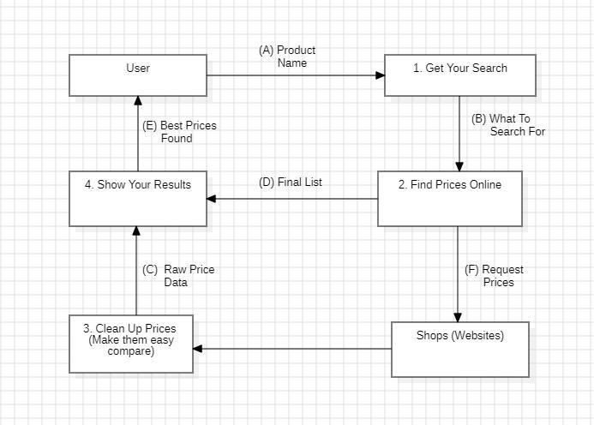
Data Flow Diagram
Fig : Price Comparison Diagram

Slide 13
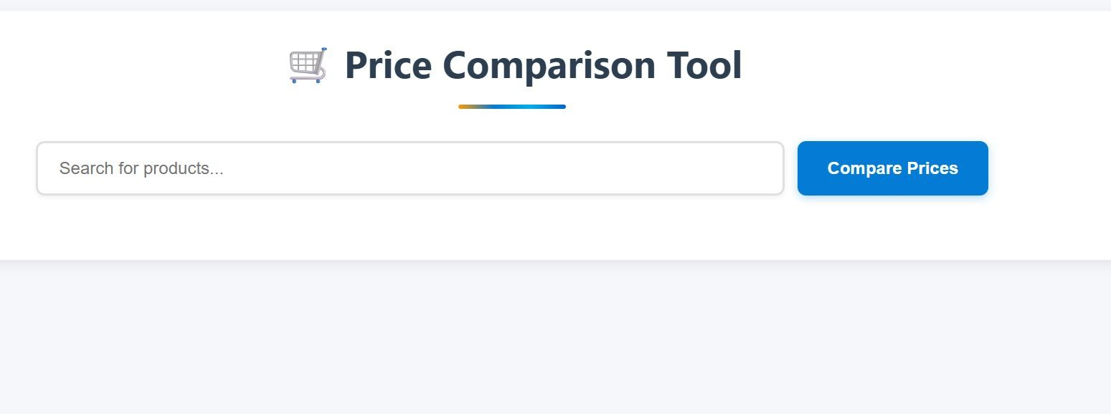
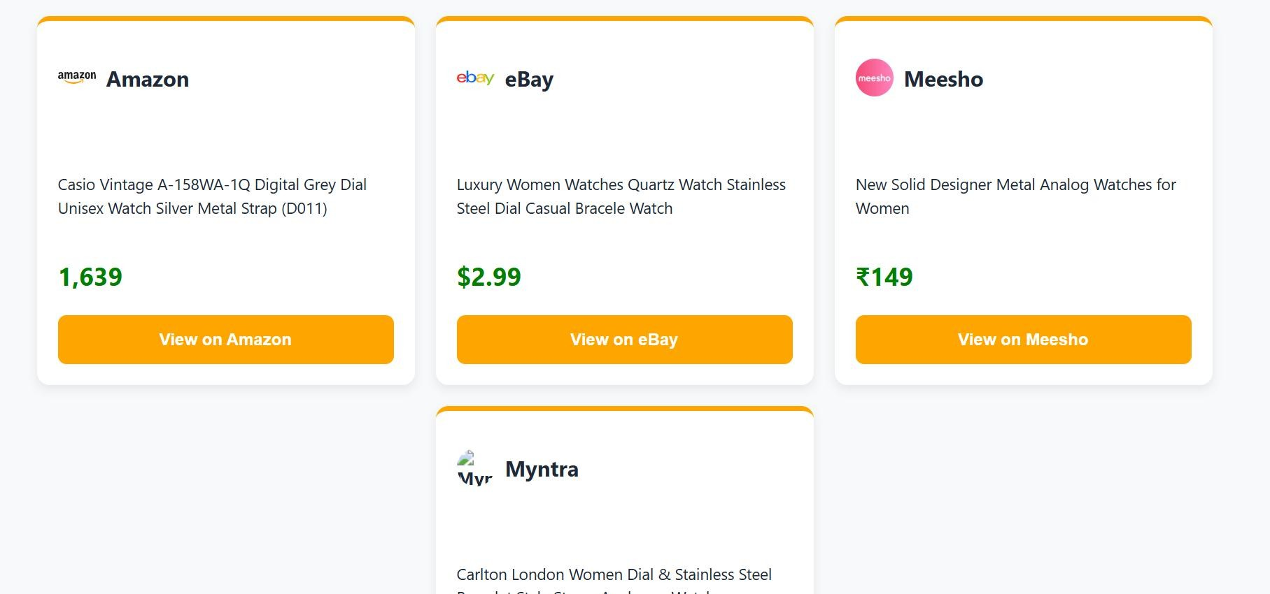
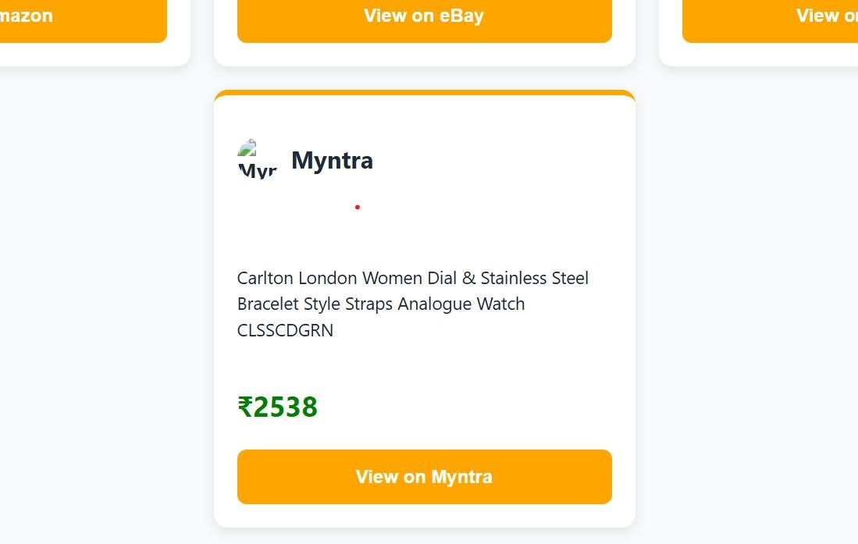
Screenshots
Fig 1: Home page
Fig 2: Results of searched product
Fig 3: Results of searched product

Slide 14
Conclusion
The Smart Price Comparison Tool provides a simple yet effective solution for users to compare product prices across multiple e-commerce platforms in one place. It enhances the online shopping experience by offering simulated real-time data, highlighting the best deals, and presenting useful information like discounts, ratings, and reviews. With its responsive design and user-friendly interface, the tool addresses the limitations of existing systems and offers a solid foundation for future enhancements, such as integrating real APIs for live price tracking. Overall, the project demonstrates how automation and smart UI design can simplify decision-making in online shopping.

Slide 15


